Slide 1
Be Drug Free
Grade 6

Slide 2
Definition of a Drug
“A drug is a substance,
other than food, which
changes the way a person
thinks, feels and acts.”
Notes:
A drug can enter the body by being ingested, smoked, injected, inhaled or absorbed (e.g. under the tongue or through on the skin)

Slide 3
Legal Drugs | Illicit/Illegal Drugs
Alcohol (19 years of age and older) Tobacco (19 years of age and older) Cannabis/Marijuana (19 years of age and older) Prescription Drugs (when prescribed to you) Over the counter medication such as Tylenol or Advil (talk to a parent or trusted adult before using to ensure product is right for you and that you are using it safely) | Cocaine Prescription Drugs (that were not prescribed to you) Ecstasy/MDMA Crystal methamphetamine Heroin
Notes:
*Government of Canada has now legalized recreational cannabis
Note that prescription drugs can be classified as either legal or illegal. This depends on whether or not the drug was prescribed to you by a doctor.
Remember all drugs (legal or not) can produce negative health outcomes.

Slide 4
Intoxicating Substances
Some everyday products, when used incorrectly, can act like a drug. They can have negative effects on an individual’s health
Often ingested or inhaled
Examples: gasoline, glue, mouthwash, hairspray
Notes:
Like other drugs, intoxicating substances can effect a number of different organs including the brain, heart, kidneys and liver. The effects of the drugs can range but may include dizziness, hallucination, nausea, loss of judgment, rapid heartrate, etc.

Slide 5
Addiction
A term used to describe a behaviour that is out of control in some way.
It includes the 4Cs
Craving
Loss of control of amount or frequency of use
Compulsion to use
Use despite consequences
Notes:
Drug use can vary widely. Many people never try drugs, while some experiment with drugs and others use them regularly or even become addicted.
All drugs have negative effects – some of those effects are felt after trying a drug even once, while others occur as people use the drugs repeatedly. You never know how a drug is going to react with your body and so experimenting with any type of drug can be dangerous.
Some young people start off in the experimental stage and wind up using drugs regularly, which leads to dependency and addiction. Once a person develops an addiction to a drug, he or she feels controlled by the drug and needs the drug to function. Addiction is characterized by the 4 C’s: Craving the drug; loss of Control of the amount of frequency of use; a Compulsion to use the drug; and continuing to use the drug despite the Consequences.

Slide 6
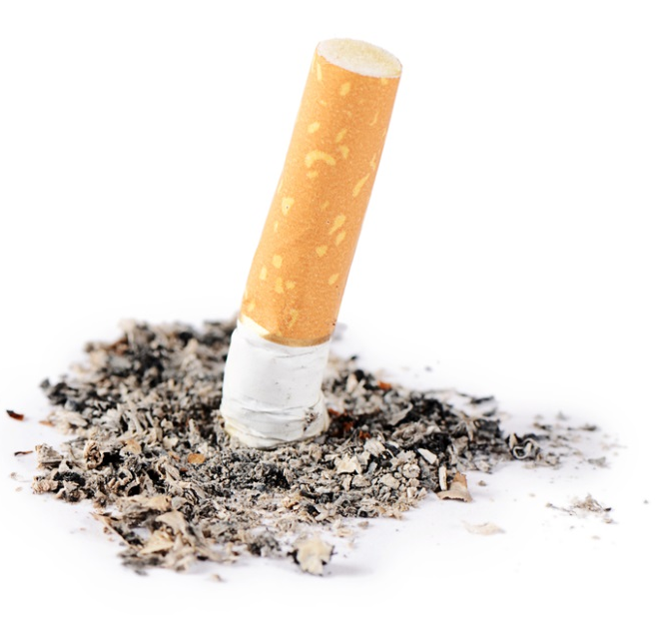
Tobacco
Most often smoked (cigarettes, cigars)
There are smokeless products
Contains Nicotine
Must be 19 years or older
Notes:
Tobacco can be smoked in the form of cigarettes, cigars, cigarillos, hookah (consists of a glass base that is partially filled with water)
Tobacco also comes in smokeless tobacco products which are typically broken down into two categories: chewing tobacco and snuff/snus (pronounced “snoose”)
Chewing tobacco is shredded, twisted, or bricked loose leaf tobacco. It is places in the mouth, between the cheek and lower lip. It is occasionally chewed. The resulting tobacco juices/saliva is typically spit out.
Snuff/snus is fine-grain tobacco. Snuff can also be places between the gum and cheek or lower lip, while snus to typically placed between the gum and upper lip. Snuff/snus does not need to be spit out.
Nicotine is the drug in tobacco that is addictive
Legal age to purchase tobacco products is 19 years of age and older

Slide 7
Effects of tobacco use
Yellow teeth
Bad breath
Cough
Decreased exercise tolerance
Lung damage
Increased risk of heart attack and stroke
Addiction
Notes:
Using tobacco has many negative consequences that will affect your life including:
Yellow teeth
Bad breath
Cough
Decreases exercise tolerance because of the decreased oxygen to the body (one cannot do sports as easily)
Among the negative consequences are some very serious health effects such as
Lung damage
Increased risk of heart attack, stroke, and addiction
Other things to consider are that your friends may not want to be around you if you use tobacco and it is a habit that costs a lot of money.

Slide 8
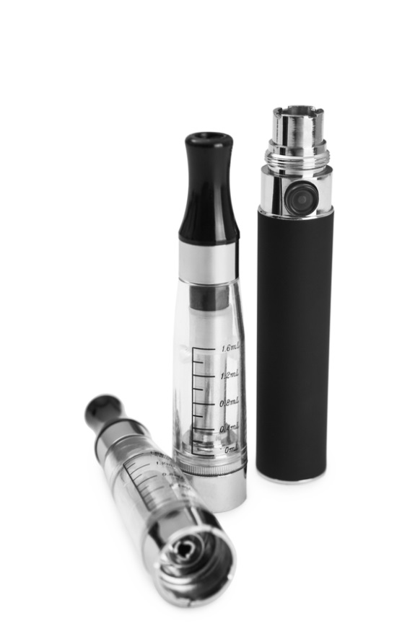
Electronic Cigarettes/Vapes
Battery operated (some have exploded)
Some cartridges of may contain nicotine (addictive)
The aerosol contains other chemicals that may be harmful
Notes:
Electronic cigarettes – commonly reffered to as e-cigarettes or “vapes”
use a battery, heating element and liquid containing cartridge (e-liquid or e-juice) to create an aerosol or vapour.
The cartridges come in different flavours which may be appealing to young people.
In Canada, e-cigarettes without nicotine are considered legal; however, Health Canada warns that they have not been fully checked for safety or quality. In fact, some cartridges that have been labeled as nicotine-free actually contain nicotine. Different cartridges may contain different amounts of nicotine. E-cigarettes containing nicotine are readily available in Canada and online.
Electronic cigarettes may be perceived as being less harmful then cigarettes, but there are still risks. Many cartridges contain nicotine and the aerosol contains other chemicals that may be harmful.
Injuries have been reported from exploding batteries in electronic cigarettes.

Slide 9
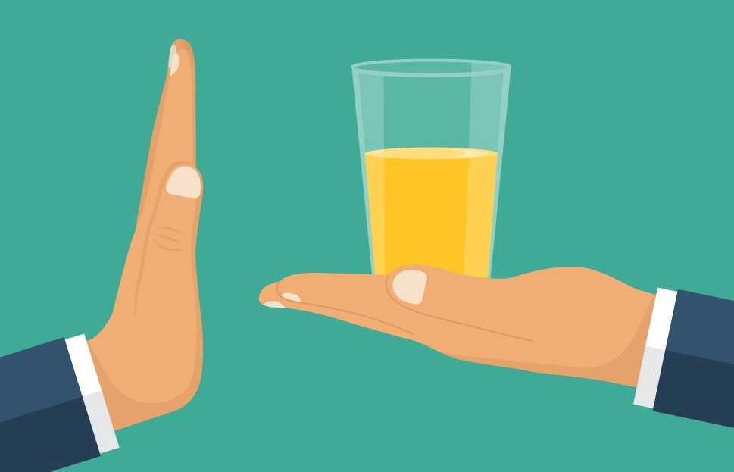
Alcohol
A depressant that slows down the brain and central nervous system, heart rate, and breathing rate.

Slide 10
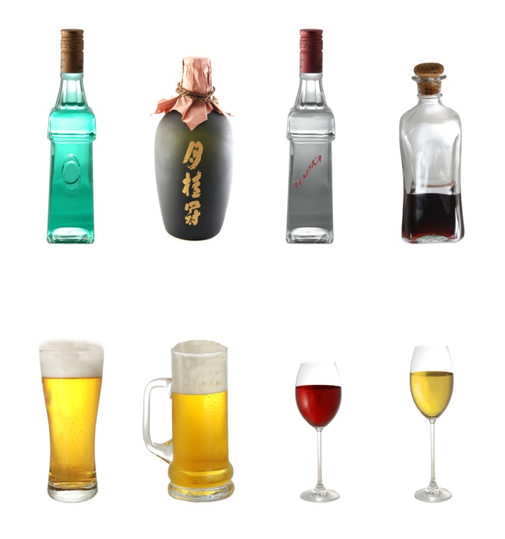
What Alcohol Does to the Body
Enters the blood stream and affects brain function
Blurred vision
Cannot react as quickly
Increased risk taking
Slurred speech
Notes:
Increases risk taking behaviours and poor decision making (i.e. risky sexual activity, dangerous activities that may cause injury)
Decreased coordination, blurred vision and decreased reaction time increases risk of injury. These affects of alcohol are also what make it dangerous to drive after drinking.
Binge drinking may result in a “hangover” the follow day. Symptoms include shakiness, nausea, headache, etc.
Alcohol use during pregnancy may result in fetal alcohol spectrum disorder (FASD) in the infant. This causes physical, cognitive, emotional and behavioural developmental disabilities in the baby.
Alcohol is addictive for some individuals.
Long term consequences may included damage to organs such as brain, liver, pancreas and stomach. The risk of cancer is also increased.
Binge drinking can lead to alcohol poisoning (discussed on next slide)

Slide 11
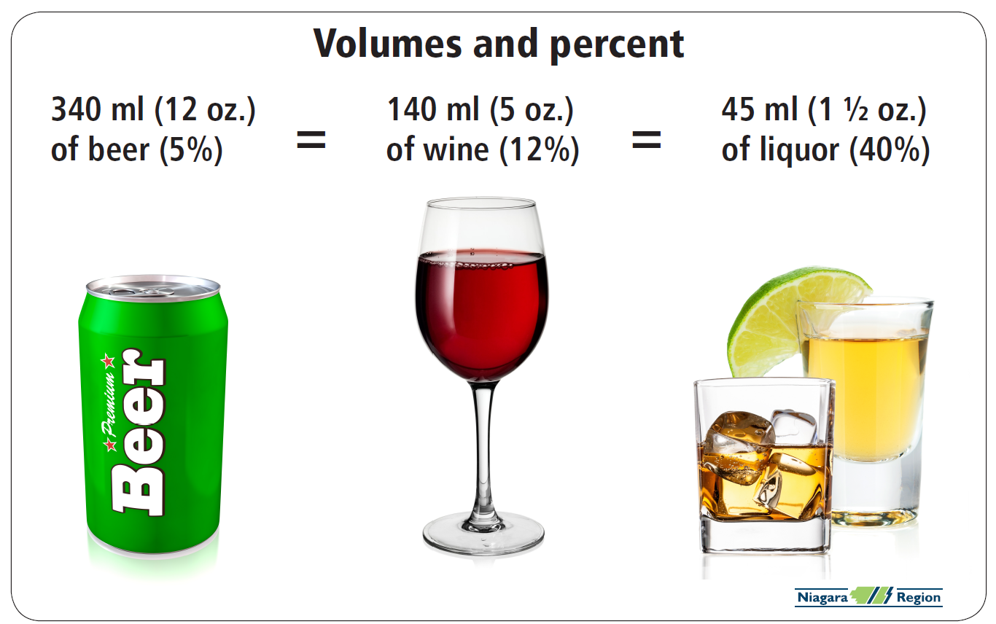
Alcohol: What is “one drink”?
Notes:
Alcohol content varies so “one drink” is a different size depending on the type of alcohol being consumed. The higher the alcohol content (indicated by the percentage), the smaller the volume of one serving.

Slide 12
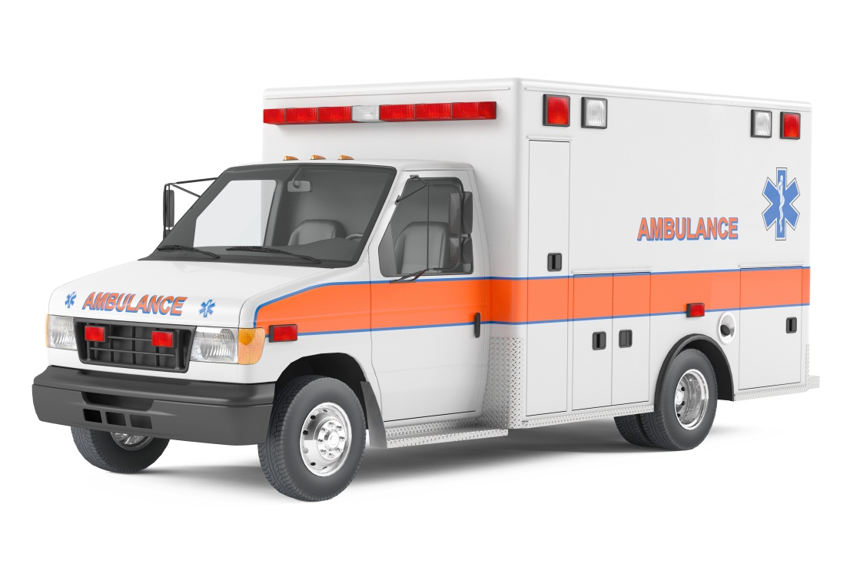
ALCOHOL POISONING
Cold/Clammy, pale or bluish skin
Slow breathing
Could vomit
Confusion
Shakiness
Slow and weak pulse
Unconsciousness (passed out)
Notes:
Binge drinking is defined as
5 or more standard drinks on one occasion for males
4 or more standard drinks on one occasion for females
Alcohol Poisoning can be fatal. Alcohol decreases breathing and heart rate. If they slow down too much this can result in death. Alcohol poisoning can also lead to loss of consciousness and vomiting as the body tried to get rid of the excess alcohol. Choking on vomit (while “passed out”) can result in death.
Alcohol poisoning is a medical emergency.

Slide 13
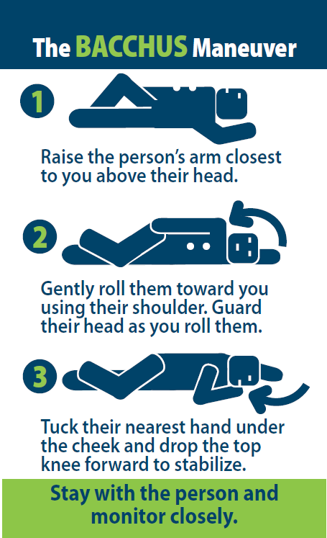
If someone passes out, try to wake them.
If they don’t respond:
Check for a pulse
Make sure the person is breathing
Use the BACCHUS MANEUVER
Stay with the person
Call 911
Notify parents or guardians
DO NOT leave the person alone
DO NOT give the person anything by mouth
DO NOT let the person sleep it off
Notes:
If someone loses consciousness after drinking and/or using drugs there are some very important steps you should take to help keep the person safe.
Check for a pulse and make sure the person is breathing.
Position the person using the Bacchus maneuver shown in the diagram here.
Option: have students practice this skill on each other.
Stay with the person and call 9-1-1. If you don’t have a phone with you and you are alone, leave to call 9-1-1 but return immediately.
Notify the person’s parents or guardians or another responsible adult as soon as possible.
Make sure you DO NOT leave the person alone. Even if the person is conscious, but is impaired, they must not be left alone as the risk is high for injuries.
To prevent choking, DO NOT give the person anything by mouth (no coffee, food, etc).
DO NOT simply let the person sleep it off. They could be dead in the morning.

Slide 14

Cannabis (Marijuana & Hashish)
Comes from cannabis sativa plant and contains the chemical THC
Street Names : pot, weed, reefer, joint, grass, Mary Jane, weed oil, honey oil, hash
Can be “laced” with other substances
Notes:
THC = tetrahydrocannabinol. It is a mind altering ingredient in the plant.
Cannabis can be consumed in many different forms including a pipe, joint, bong, in food, etc. It can also be smoked in a blunt which is a cigar that has been emptied of tobacco and refilled with a combination of tobacco and marijuana. This methods combines the dangerous chemicals of cannabis with nicotine and other harmful chemicals.
Recreational cannabis became legalized in Canada on October 17, 2018. You must be 19 years of age and older to buy, use, possess and grow cannabis.
Stress that less than one quarter (19%) of students in grades 7-12 report using marijuana in the last year. This means that about 80% of students do not use cannabis. (OSDUHS, 2017)

Slide 15

Cannabis … What does it do to your Body?
Increased appetite (munchies)
Loss of coordination
Decreased concentration
Hallucinations
Memory loss
Lung disease
Addiction
Notes:
Cannabis increases heart rate which can lead to increased risk of heart attacks.
Cannabis smoke contains carcinogens (cancer causing agents)
Can negatively affect daily life or exacerbate existing problems. For example, decreased concentration can impact academic performance. It is dangerous to drive or operate heavy machinery after using cannabis.
Contrary to popular belief, marijuana is addictive. Research suggests that those who start using at a younger age are at increased risk for addiction.

Slide 16
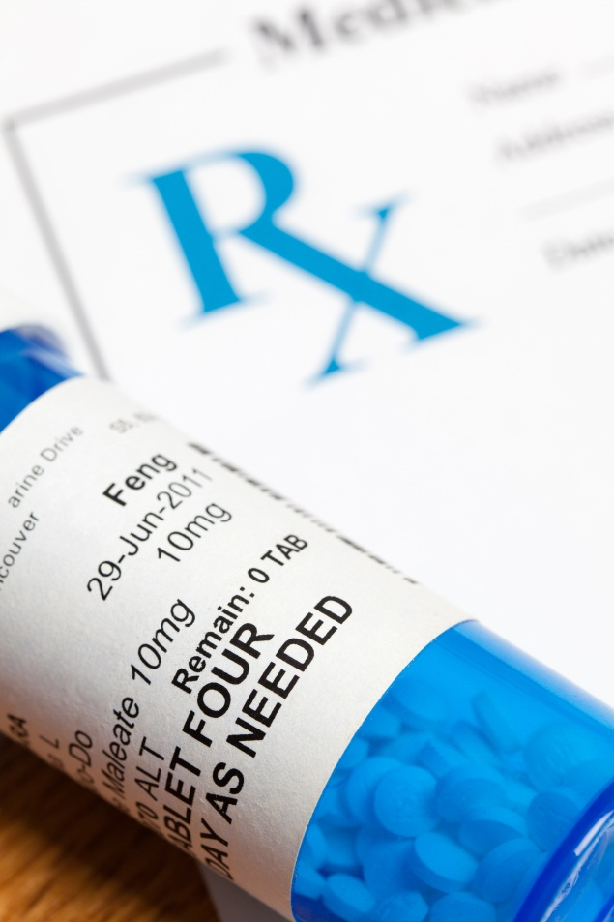
Non-medical Use of Prescription Drugs
Examples
Never take somebody else’s prescription medications
Taking prescription drugs without a doctor’s supervision can be just as dangerous as using illegal drugs
Pain Killers
ADHD Medications
Sleeping Pills
Notes:
The non-medical use of prescription drugs is taking other people’s prescription medication to get high
Taking prescription drugs that are not prescribed to you can be just as dangerous as using illegal/illicit drugs. Drugs, including prescription drugs, have unwanted and potentially dangerous side effects (eg. Decreased breathing). Prescription pain killers (eg. Fentanyl, percocet, oxycontin, Tylenol #3,) are highly addictive.
It is illegal to take prescription medication that is not prescribed to you.

Slide 17
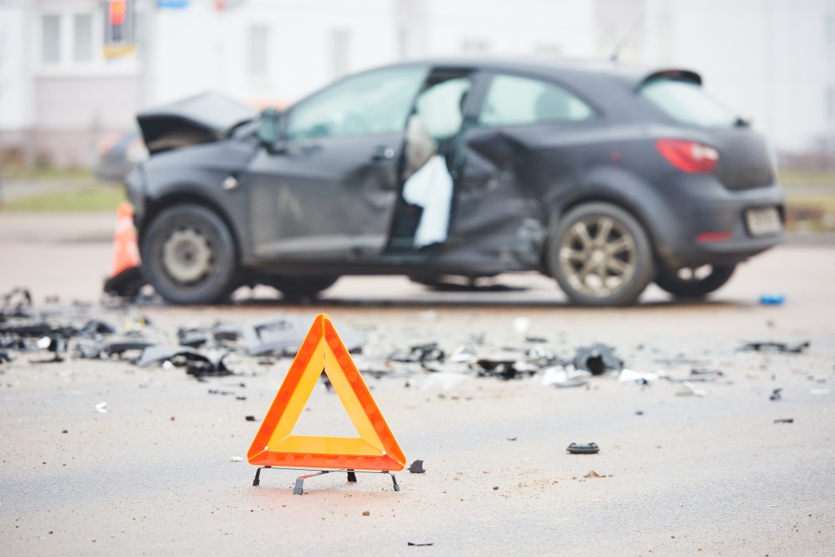
Consequences of Drugs and Alcohol
Decreased athletic performance
Poor grades
More fights and more injuries
Sexual assault/dating violence
Vehicle crashes
Decrease decision making ability
Notes:
Other examples might include:
Financial problems
Inability to make good decisions
Injury, death, or legal charges as a result of accidents or violence while impaired
Fetal Alcohol Spectrum Disorder (FASD) in children as a result of alcohol abuse by the mother during pregnancy
Decreased Athletic Performance
Extra Weight
Hangovers
Decreased Motor Skills (eye, hand, brain coordination)
More Fights
Decreased Judgement
Decreased Sensitivity
Sexual Assault
Won’t take “no”
Won’t hear “no”
Passed out
More Injuries
Railroad
Pools
Falls
Vehicle Crashes
Motor Vehicle (i.e. bicycle, car, boat, ATV)
15% of all students (Gr 7-12) report being a passenger with driver who has been drinking (OSDUHS, 2015).
12% of students reported being a passenger with a driver who had been using drugs (OSDUHS, 2015)
Impairment, speed and driver error are the main reasons for vehicle crashes.

Slide 18
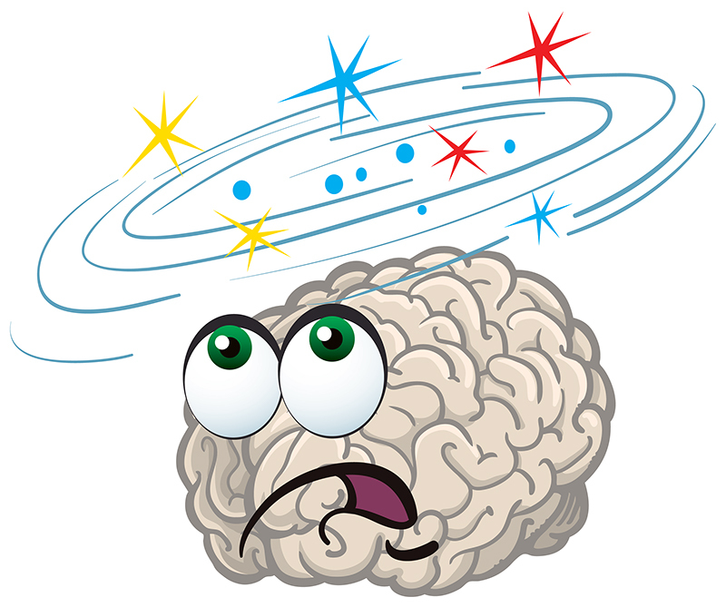
Reasons why some young people use drugs…
symbol of being ‘mature’
to have fun
to rebel authority
to increase confidence
to cope with concerns about body image
to be “cool” and “fit in” with friends
to cope with mental health issues/problems and stress
curiosity
Notes:
If we know that drugs cause many negative effects, why do some people use them? Young people may try or use drugs because they think it will make them appear mature, feel more confident, fit in or be cool. They might also try drugs because they are curious, they want to rebel, or they think it will be fun.
Young people face many challenges and sometimes they turn to drugs thinking they will help them cope. For example, they may think that drugs will help them cope with concerns about their appearance and body image, or to cope with stress and mental health issues. Unfortunately, instead of helping, drugs often make these problems much worse .

Slide 19

Mental Health and Substance Abuse
Problematic substance use and mental illness can be closely connected
Mental illness may contribute to problematic substance use
OR
Long-term drug use can lead to the development of mental illnesses
Notes:
Suggest to students that they can look for these warning signs in a friend they may be concerned has mental health issues
Frequently sad, depressed, anxious, or rebellious
Difficulty paying attention
Problems with eating, sleeping, or getting along at school
Being addicted to substances
Ask students for examples of mental illnesses that are sometimes connected with problem substance use.
Examples are:
Depression
Eating disorders
Anxiety disorders
Bipolar disorder
Schizophrenia

Slide 20
Staying Safe
Good friends
Refusal skills (knowing how to say “No”)
Safety agreement
Texting a Code Word
Knowing where to go for help
Notes:
There are some things that can help you to stay drug-free.
Having a good friend can make you less likely to use drugs. What does it mean to be a good friend? (someone who accepts you/your decisions, looks out for you; does not pressure you to do something you don’t want to do; positive peer influence; can recommend people and places to go to for help when dealing with problems and difficult choices)
It can also help to have interests – especially those that you share with your friends – that you can do instead of using drugs or alcohol. What do you think some of those could be? (sports, starting a band, being in the school play/talent show, video games, etc)
Knowing how to say “no” is important to helping you stay drug-free. It can be very difficult to say “no” to friends or peers without offending them or feeling singled out. That’s why it helps to have some strategies to deal with those situations. If a friend offers you beer or a cigarette, how can you refuse it? Some strategies include: avoid the group, walk away, give a reason or excuse (e.g. training for track and field), suggest an alternative (e.g. going to the movies), say “Can you imagine if my parents found out? No way – I want to live until at least tomorrow”, say “respect my decision – I respect yours”, say “Look I’d rather not”, say “I’ll catch up with you tomorrow – I’ve got other things I’d like to do”.
You can also create a Safety agreement with your parents or guardians and plan to have them pick you up if you don’t have a safe ride home without asking questions about what happened or waiting to ask questions until the next day. The rules about this agreement would be decided together.
Another arrangement you could make with your parents/guardians is choosing a Code Word or symbol that you can text to them if you need to ask them for help. You would simply text the Code Word to your parents and they would call you back and make up an excuse for you to leave the situation and arrange a safe ride home.
It is also important to know where to go for help. For example, you might go to a trusted adult, like a parent, teacher, doctor, or coach, to ask them for help or advice. You might also consult one of the community resources that are available. [list on next slide]

Slide 21

If you need help:
Kids Help Phone (1-800-668-6868)
Mental Health Helpline (1-866-531-2600) or www.mentalhealthhelpline.ca
Community Addictions Services of Niagara (CASON) (905-684-1183)
Parents/Trusted Adult
Teacher/Principal/VP
Child and Youth Worker
Public Health Nurse
Doctor
Notes:
The Mental Health Helpline provides information about mental health services in Ontario.
At www.mentalhealthhelpline.ca individuals can ask for help via email or live chat.
Community Addictions Services of Niagara (CASON) www.cason.ca; (905) 684-1183
Pathstone Crisis Services (1-800-263-4944)
Al-Anon/Alateen (if you are bothered by someone else’s drinking) 905-328-1677 or 1-888-425-2666

